Slide 1
CAMARA EdgeCloud Meeting 19th December

Slide 2
INSERT SUBHEADING
Agenda
Cleaning status of auxiliary branches
Harmonization of concepts/items among Simple Edge Discovery/MVP/Traffic Influence
Other implementation details: PR159
Main changes in EdgeCloud MVP (PR 154) following previous meeting

Slide 3
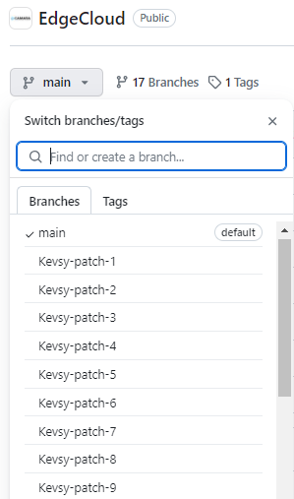
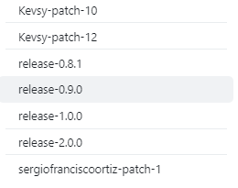
1.- Cleaning status of auxiliary branches

Slide 4
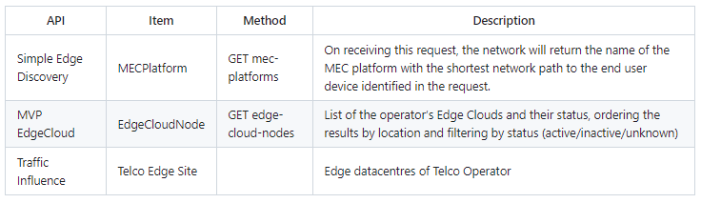
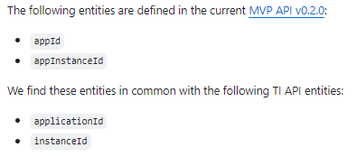
2.- Harmonization of concepts/items among Simple Edge Discovery/MVP/Traffic Influence
Issue 163 Harmonization of Edge Entitys among EdgeCloud APIS for future merge
Issue 164 TI and MVP API - Harmonization of common entities

Slide 5
3.- Other implementation details
How will end user know the URI to connect to ? Review discussion in PR PR 159
Continuation of discussion in previous meeting
Included in MVP API Get methods to obtain URI for existing AppInstances
Review of other topics from last comments in open pull requests

Slide 6
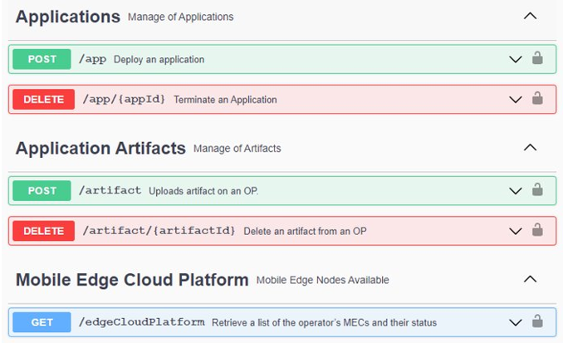
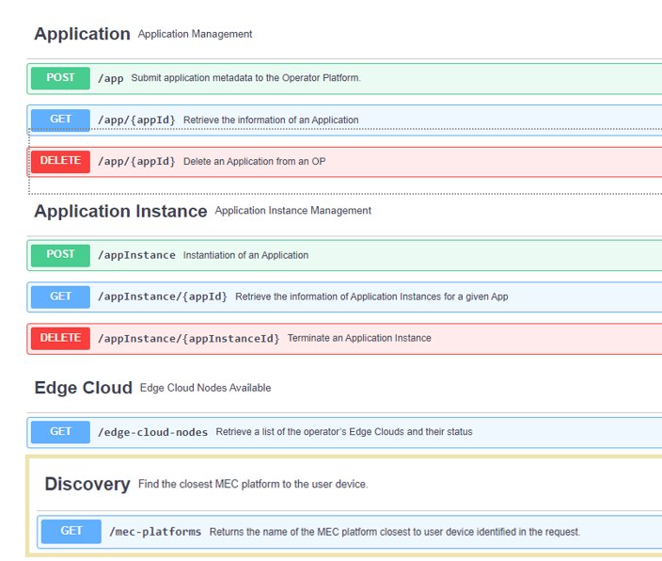
4.- Main changes in EdgeCloud MVP following.
Goal Merge into main branch and include further changes in separated PRs.
Combined Artifact and Application into a single type
Added get methods for Application and AppInstances ( included status for app instance)
V0.1.0
V0.2.0

Slide 7
Backup

